Slide 1
PROJECT TELECOMMUNICATIONS_CHURN
TEAM MEMBERS:Group 2
Mr.Suraj Tirgul
Mr.Dhiraj Hajare
Ms.Pooja Pawar
Mr.Saurabh Sigh
Mr.Alexander Kumarsamy
Mr.Tushar Padavi
Ms.Nehal Mistry
Mmentors
Mr. Rajshekar
Miss. Pallavi

Slide 2
CONTENT
Business Problem Understanding
Objective
Data Summary
Exploratory Data Analysis
Recommendation
Conclusion

Slide 3
BUSINESS PROBLEM UNDERSTANDING
Customer churn in the telecom industry poses one of the most significant risks to loss of revenue.
their annual churn rates are usually higher than 10%.
For that reason, they develop strategies to keep as many clients as possible..
To reduce customer churn, telecom companies need to predict which customers are at high risk of churn for this we taking advantage of the vast streams of rich telecom customer data.
This project aims to analyse the data to determine the cause of customer churn. Customers who are most likely subject to churn, and what to do to retain the most valuable customer.

Slide 4
BUSINESS OBJECTIVE
Customer churn is a big problem for telecommunications companies. Indeed, their annual churn rates are usually higher than 10%. For that reason, they develop strategies to keep as many clients as possible. This is a classification project since the variable to be predicted is binary (churn or loyal customer). The goal here is to model churn probability, conditioned on the customer features.

Slide 5

DATA SUMMARY
Numerical Data
Number vmail messages
Total day minutes
Total day calls
Total day charge
Total eve minutes
Total eve calls
Total eve charge
Total night minutes
Total night calls
Total night charge
Total intl minutes
Total intl calls
Total intl charge
Customer service calls
Account length
International plan
Voicemail plan
Churn

Slide 6
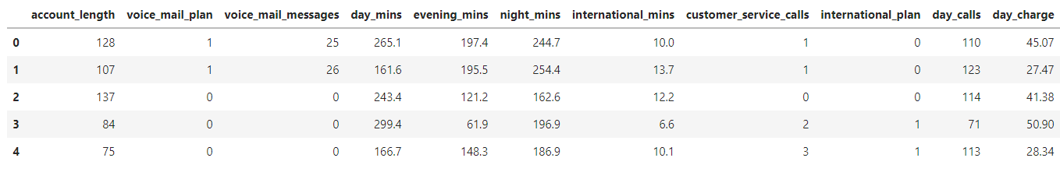
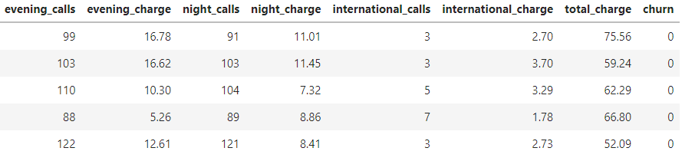
DATA SUMMARY
This is The Orange Telecom Churn Dataset.In the below table it’s show the top 5 rows respectively

Slide 7
FEATURES DESCRIPTION
ACCOUNT LENGTH:It is the length that the customer used their accoun
TOTAL (DAY/EVENING/NIGHT/INTERNATIONAL) (MINUTES/CALLS/CHARGES):
These are total 12 columns, and all are numerical data types.These contain the data of calls, minutes, charges of the customer with respective to the various time of the day and plan.
INTERNATIONAL PLAN & VOICEMAIL PLAN:
Both column are described as a categorical feature,yes means plan taken, no means plan not taken
NO. OF VOICEMAIL MESSAGES:The number of voicemail make by the voicemail plan taken customer
Customer service calls:It is the number of calls made by the customer to operator service centre
Churn:it is our target dependent variable having boolean data type of true and false

Slide 8
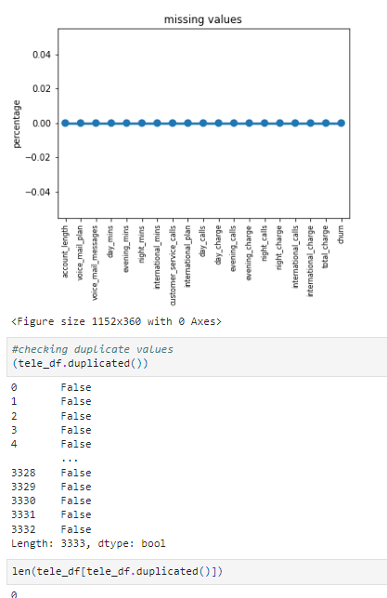
Checking Missing & Duplicate Values
NO any duplicate value in present data set
there are 3333 rows and 20 columns
& one datatype is boolen = (churn)
8 flot data type & 8 interger data type

Slide 9
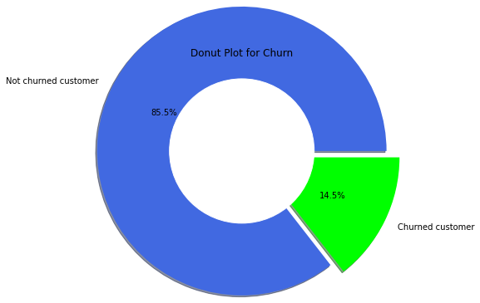
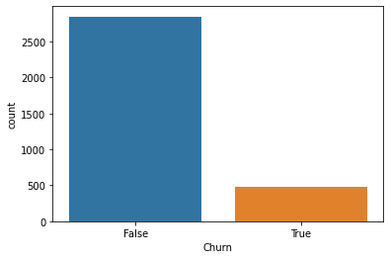
ANALYZING DEPENDENT VARIABLE
“CHURN”
Below plot on the left side is a donut plot shows the percentage of total churned and not churned customer
And on the right side count plot shows the number of customer churned and not churned
After analyzing the churn column, we had little to say like almost 15% of customers have churned.
let's see what other features say to us and what relation we get after correlated with churn

Slide 10
ANALYZING DEPENDENT VARIABLE “CHURN”
Total Users number - 3333.
2850 - Non churn (85.5%)
483 - Churn (14.5%)
From the above donut plot and count plot, It was found from this analysis that almost 14.5% of customers had churned .

Slide 11
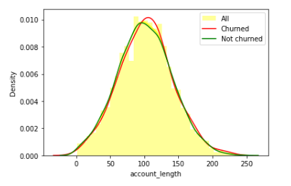
ACCOUNT LENGTH vs. CHURN
This Plot show effect of Account Length on Churn
Here is no sign of customers leaving because of the length of usage of their account.
After analyzing various aspects of the "account length" column we didn't found any useful relation to churn. so we aren't able to build any connection to the churn as of now. let's see what other features say about the churn.

Slide 12
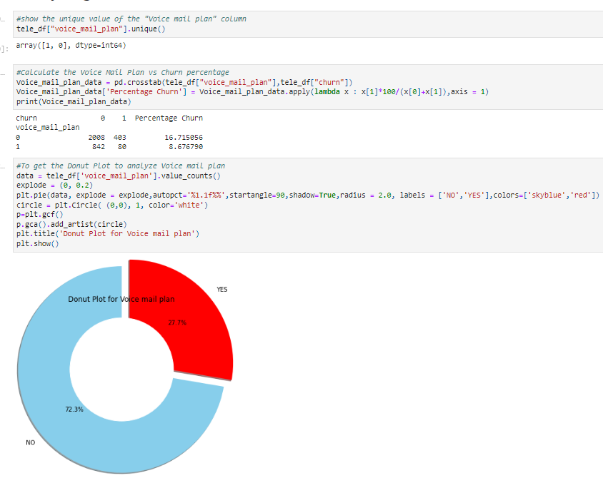
ANALYSIS OF VOICEMAIL PLAN
There are 3333 people,
922 having Voicemail plan,
2411 do not have any Voicemail plan.

Slide 13
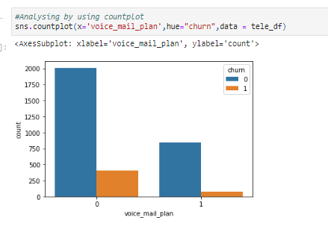
VOICEMAIL PLAN vs. CHURN
As we can see there is are no clear relation between voice mail plan and churn so we can't clearly say anything so let's move to the next voice mail feature i.e number of voice mail, let's see what it gives to us.
This plot shows churn corresponding with the subscription of voicemail plan Out of 922 people having Voicemail plan, 8.7% are Churn.

Slide 14
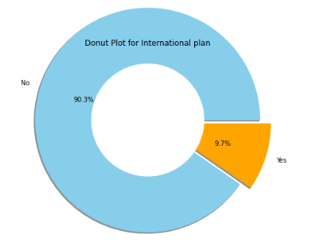
Anal "International Plan" column
Analyzing “International Plan” column
There are 3333 people
323 have a International Plan
3010 do not have International Plan

Slide 15
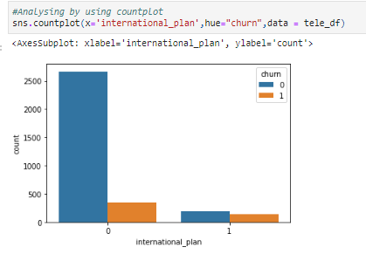
International Plan vs. CHURN
This is a count plot which shows the churned and not churned customer respective to their international plan
From the above data we get
There are 3010 customers who dont have a international plan.
There are 323 customers who have a international plan.
Among those who have a international plan 42.4 % people churn.
Whereas among those who dont have a international plan only 11.4 % people churn.
So basically the people who bought International plans are churning in big numbers.
Probably because of connectivity issues or high call charge.

Slide 16
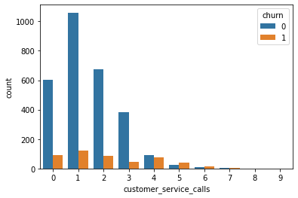
Analyzing "Customer service calls" column
It is observed from the above analysis that, mostly because of bad customer service, people tend to leave the operator.is obehe above analysis that, mostly because of bad customer service, people t
The above data indicating that those customers who called the service center 5 times or above those customer churn percentage is higher than 60%,
And customers who have called once also have a high churn rate indicating their issue was not solved in the first attempt.
So operator should work to improve the service call.
r.
The above

Slide 17
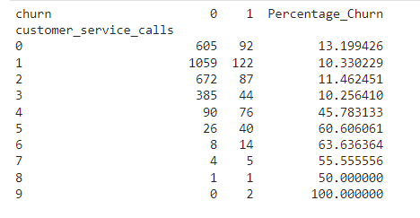
Customer service calls Vs CHURN
This table mapping number of customer calls to the churn percentage
It’s clear that after 4 calls at least 45% of the subscribers churn.
Customers with more than 4 service calls their probability of leaving is more

Slide 18
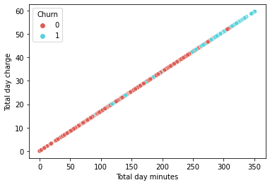
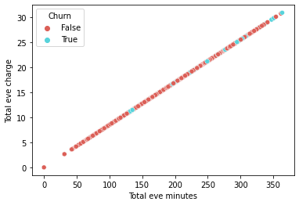
ANALYZING ALL CALLS MINUTES,ALL CALLS, ALL CALLS CHARGE
Analyzing all calls minutes,all calls all calls charge
Below plots are scatter plot which shows the relation between calls and churn
Left side plot shows the Total day minutes,Total day charge
With churn
Right side plot shows the Total eve minutes,Total eve charge
With churn

Slide 19
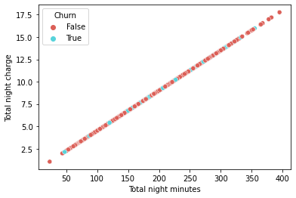
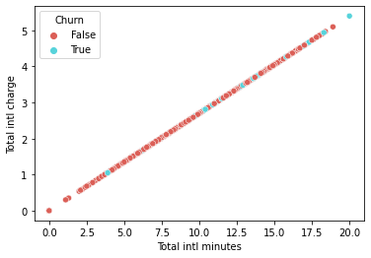
ANALYZING ALL CALLS MINUTES,ALL CALLS, ALL CALLS CHARGE
Analyzing All Calls Minutes, All Calls, All Calls Charge
Left side scatter plot shows the Total night minutes,Total night charge
With churn
Right side plot shows the Total international minutes,Total international charge With churn

Slide 20
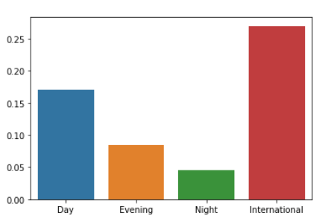
Analyzing all calls minutes,all calls, all calls charge together
this bar plot shows the comparison between all call charges per minute International call charges are high as compare to others it's an obvious thing but that may be a cause for international plan customers to churn out.
After analyzing the above dataset we have noticed that total day/night/eve minutes/call/charges are not put any kind of cause for churn rate. But international call charges are high as compare to others it's an obvious thing but that may be a cause for international plan customers to churn out.

Slide 21
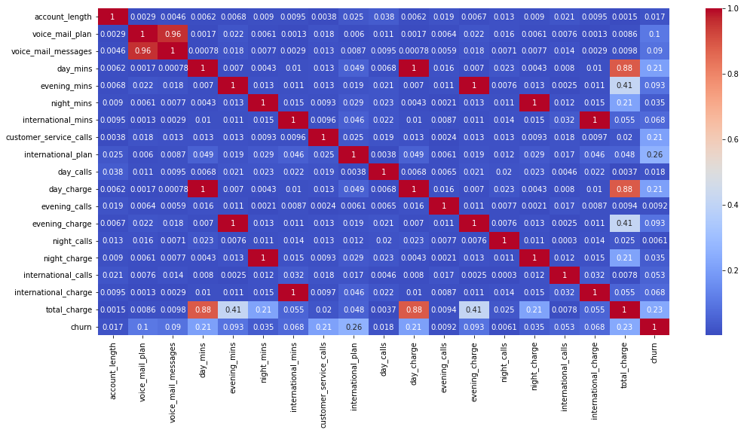
CORRELATION MATRIX

Slide 22
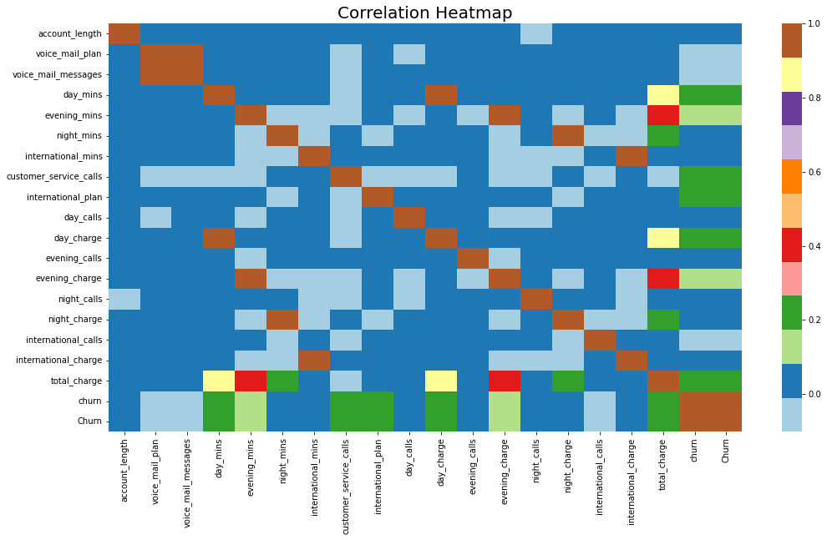
CORRELATION HEATMAP

Slide 23
CONCLUSION
account length do not play any kind of role regarding the churn rate.
In the international plan those customers who have this plan are churn more and also the international calling charges are also high so the customer who has the plan unsatisfied with network issues and high call charge.
In the voicemail section when there are more than 20 voice-mail messages then there is a churn so it basically means that the quality of voice mail is not good.
The customer who have high day call minutes also have high call price these customer tends to churn.
In customer service calls data shows us that whenever an unsatisfied customer called the service centre the churn rate is high, which means the service centre didn't resolve the customer issue.

Slide 24
RECOMMENDATIONS
Improve network coverage churned status
In international plan provide some discount plan to the customer
Improve the voicemail quality or take feedback from the customer
Provide discount to those customer who spent more minutes
Improve the service of call centre and take frequently feedback from the customer regarding their issue and try to solve it as soon as possible

Slide 25
FEATURE
ENGINEERING
PART

Slide 26
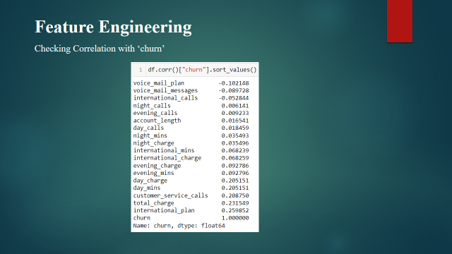

Slide 27
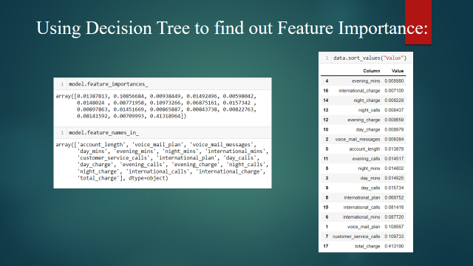

Slide 28
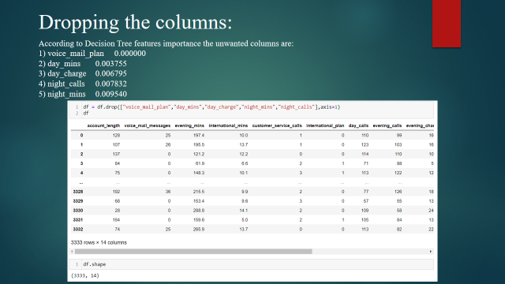

Slide 29
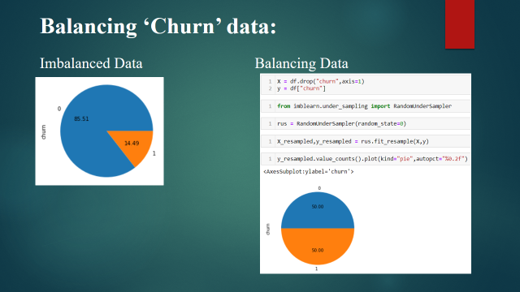


Slide 30
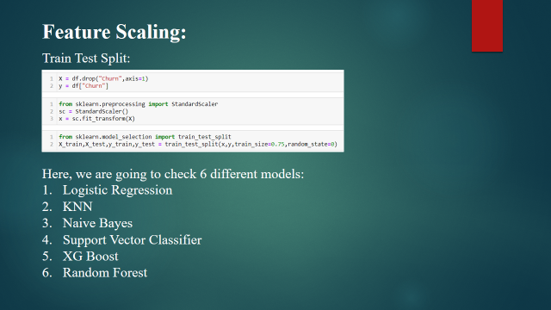

Slide 31
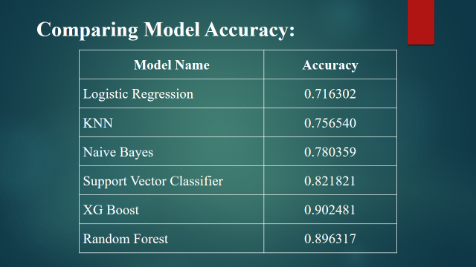

Slide 32
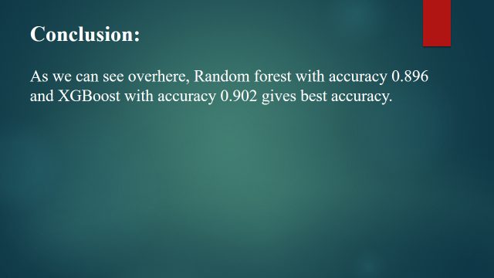

Slide 33
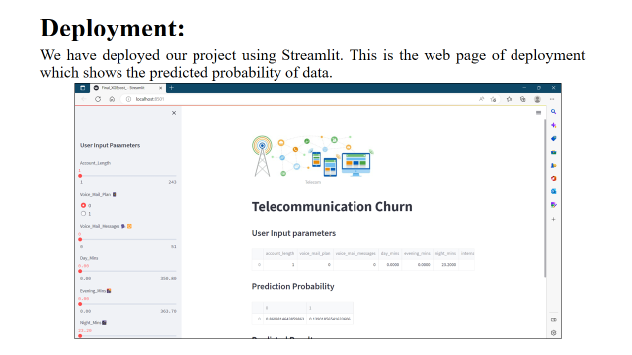

Slide 34
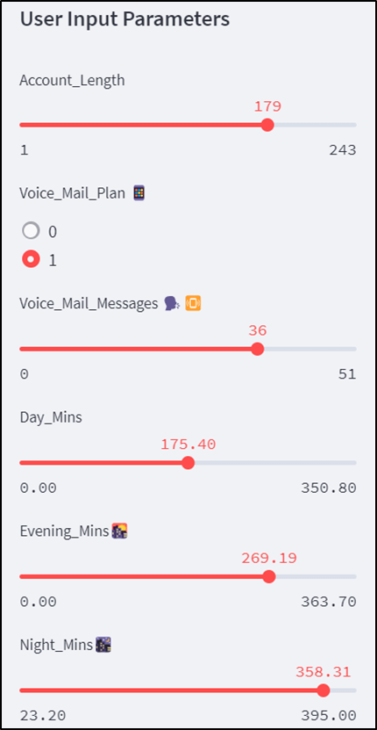
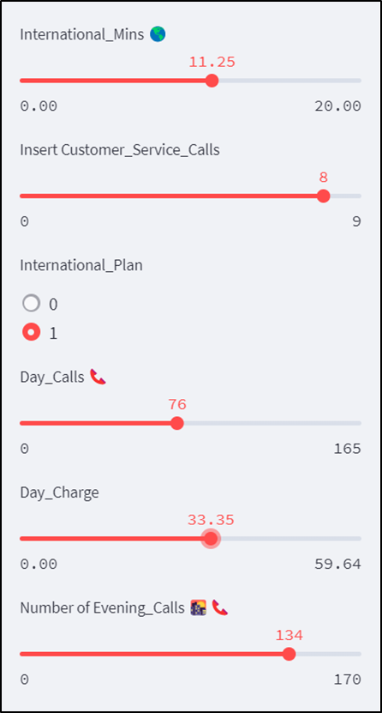
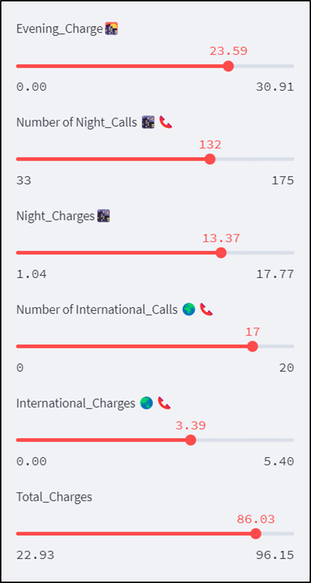
Changed Input Parameters:

Slide 35
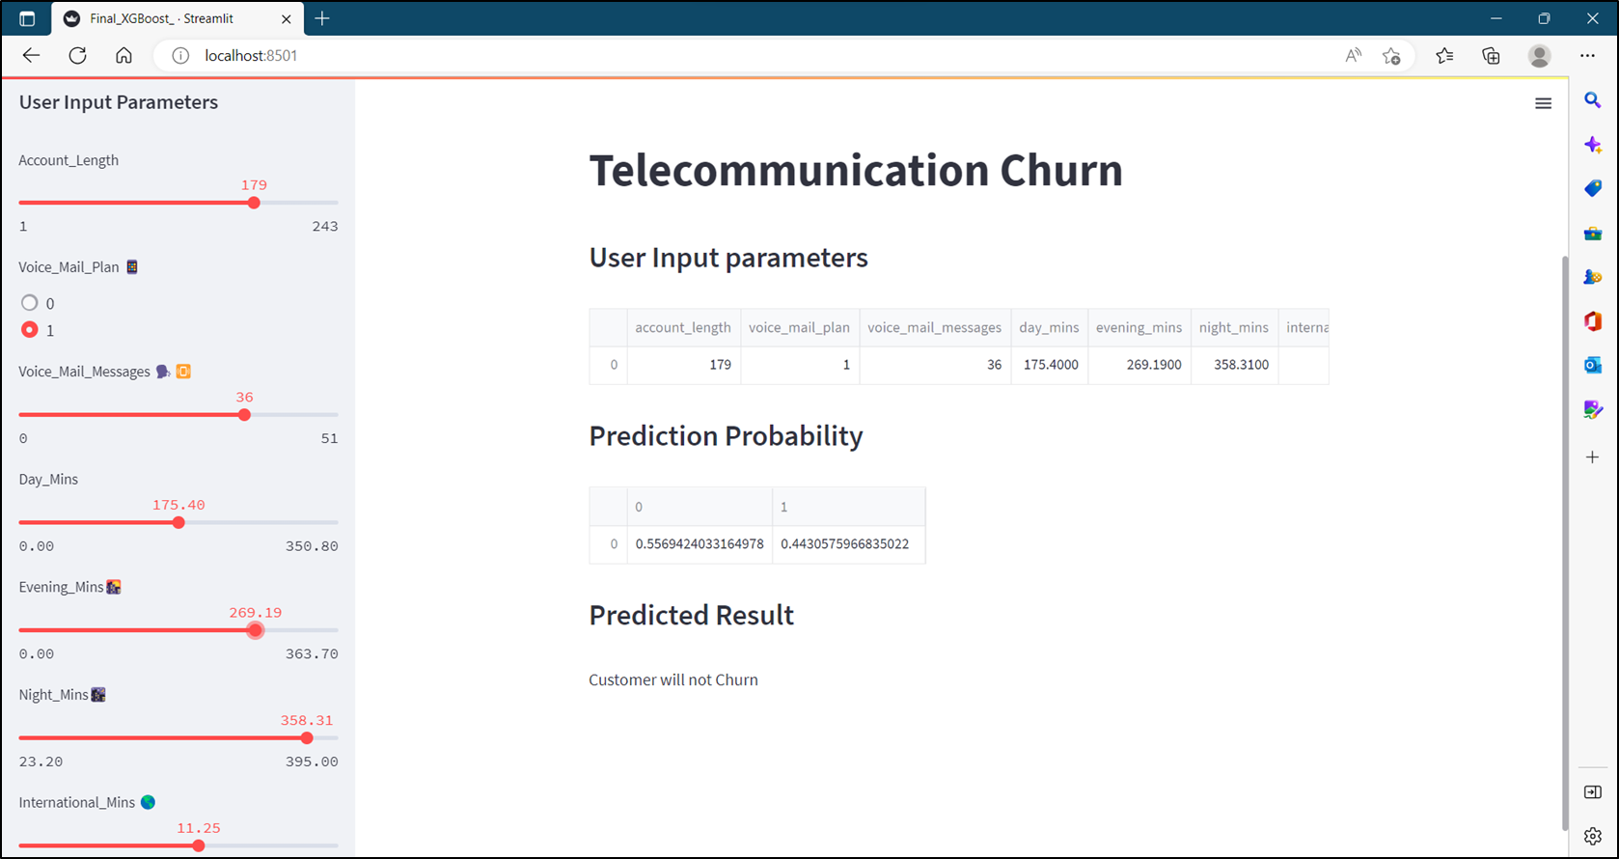
This picture shows the changed probability prediction when input parameters are changed and the result is is predicted as the ‘Customer will not Churn’. Hence, here the Churn probability completely depends upon the changes which are done in input parameters

Slide 36
THANK YOU

